Slide 1
Regina Food Bank
Team Strawberries

Slide 2
Team Strawberries
Arika Pasha
Zhimu Li
Nisarg Shah

Slide 3
Envisioned Problem/Opportunity
Problem: The Regina Food Bank phone operators were overwhelmed by the high call volumes they were receiving and were unable to attend to each customer immediately. High wait times have resulted in customers dropping the call because they do not know when their call will be answered.
Business Need and Opportunity: The food bank wants to limit the amount of call drops so all customers who are facing food insecurity get the food they need. We had the opportunity to develop a solution that allows customers to book hampers 24/7. This would decreases the call drops and thus, result in more people with food insecurity being assisted by the food bank since they can order their hampers at any time on their own.

Slide 4
Northstar & Carryover Customers
Northstar Customers
Customers of the food bank facing food insecurity since they will be directly interacting with the website to order hampers.
Carryover Customers
The phone operators: the website will allow customers to order online so the volume of calls will decrease.
The food bank employees: since it is easier to book online, there would be fewer instances of employees scrambling to quickly put together a hamper for customers who did not book.

Slide 5
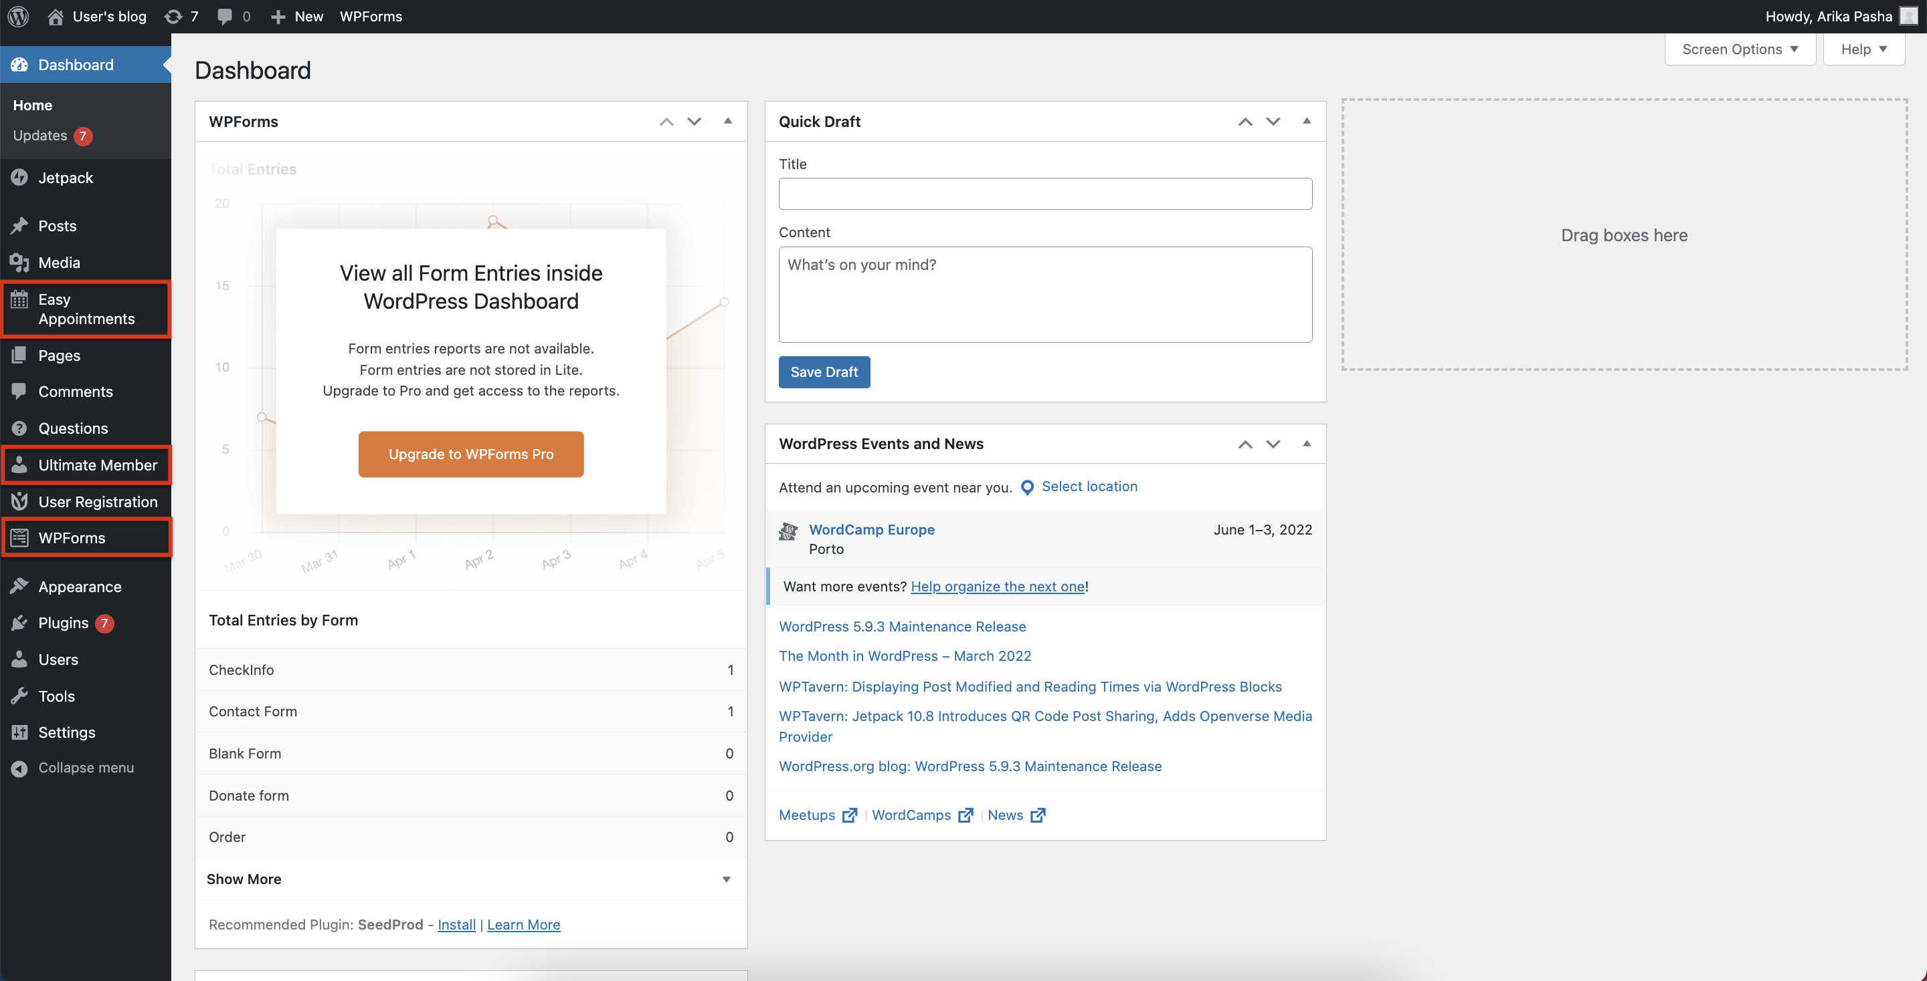
Plugins & Theme

